Slide 1




The below slides were presented by Randy Delenikos of LAKOS at World Ag Expo 2017 on Feb 16, 2017
The seminar was hosted by the International Center for Water Technology (ICWT) at Fresno State and California Agricultural Irrigation Association (CAIA)
All slides are property of LAKOS, A Lindsay Company

Slide 2
Do’s & Don’ts of Irrigation Filter Selection
Selection Guidelines
Tips for Best Results
Material Considerations

Slide 3
Don’t just buy what your neighbor is using
Applications vary
Water sources vary
  Water wells vs. canals & ponds
  Fast-moving vs. stagnant water
Particle contamination varies

Slide 4
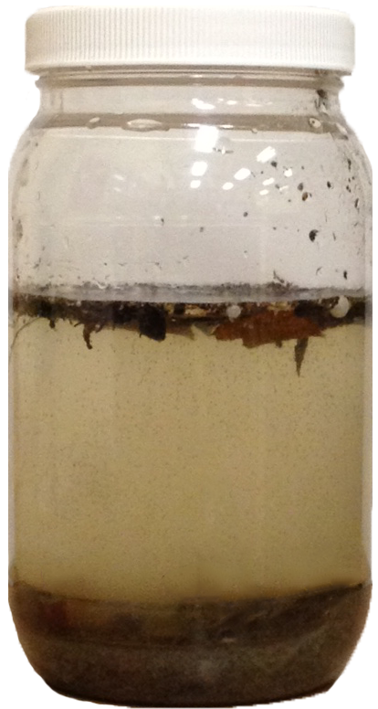
Do focus on performance
What’s in the water?
  Organics
  Sand
  Debris
What’s the water source?
  Water well
  Canal or surface water
  Pond or lagoon
What are you trying to protect?

Slide 5
Do focus on performance
Method of particle removal
  Screens vs. organics
  Separation vs. organics
Capacity for load handling
  Surface area is key
  Screen mesh can be troublesome
Consider two or more filters

Slide 6
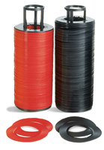
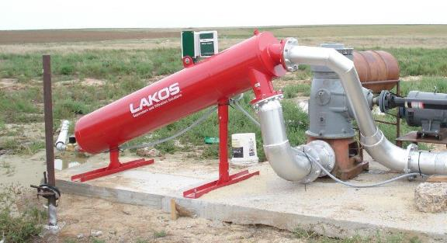
Don’t assume all filters are alike
Screens & Disc Filters
  Best for hard particles
  Limited loads
  Good for variable flows
  Can be automated
Separators
  Only remove settleable particles
  Limited to specific flow ranges
  High load capacity
  Can be automated

Slide 7
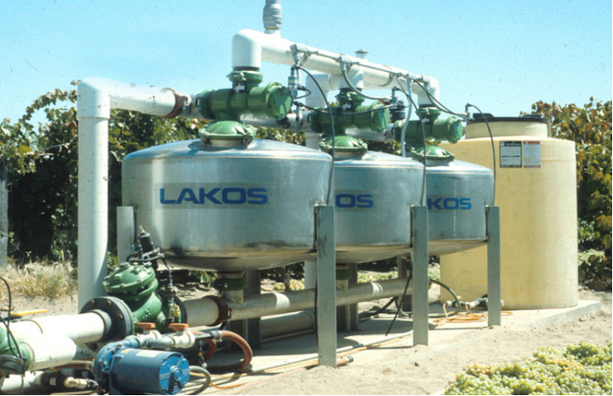
Don’t assume all filters are alike
Sand Media Filters
  Best for organics
  Watch out for sand
  Limited loads vs. expand the system
  Some flow variability; minimum for backwashing
  Underdrains are the key
    Flow-through
    Backwashing
    Pressure requirements

Slide 8
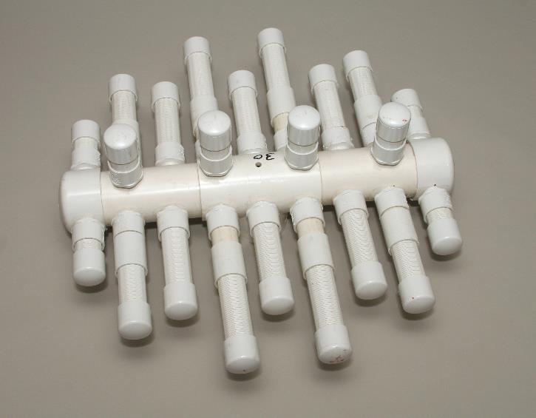
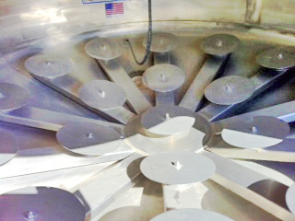
Sand Filter Underdrains

Slide 9
Sand Filter Construction
Body Materials
  Stainless steel
  Fiberglass
  Powder-coated steel
Underdrain Materials
  Stainless steel
  Injection-molded PVC
Backwash Valves

Slide 10
Do consider backwash water loss
Higher pressures
Longer flow cycles
Less cleaning, more cycles

Slide 11
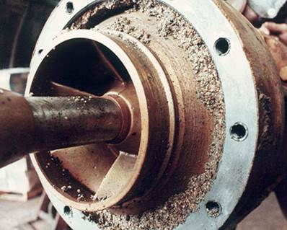
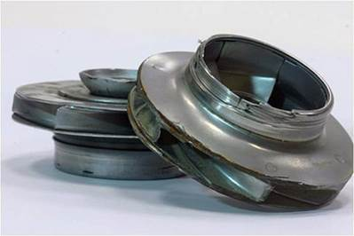
Don’t forget to protect the pump
Drought conditions are not over
Pump efficiency can be a major power cost
Pump repairs/replacements are costly

Slide 12
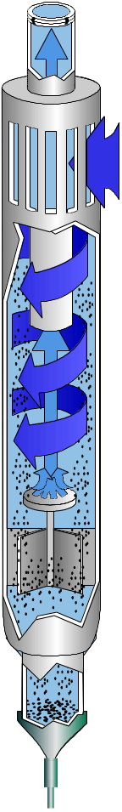
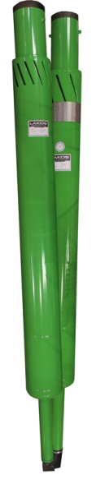
Do look at the technologies available
Pump Protection Sand Separators
  Installs on the pump suction
  Extends pump life
  Models for turbine & submersible pumps

Slide 13
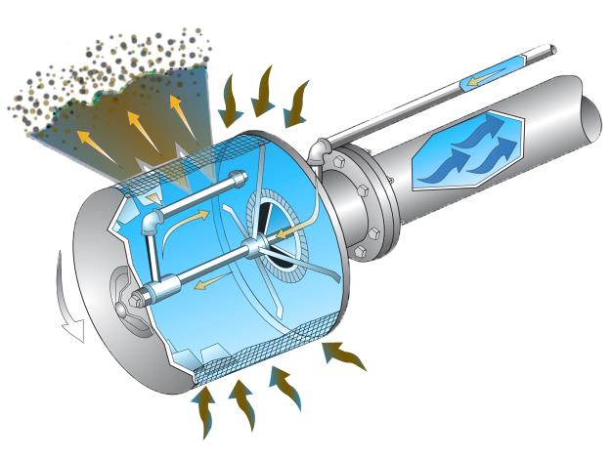
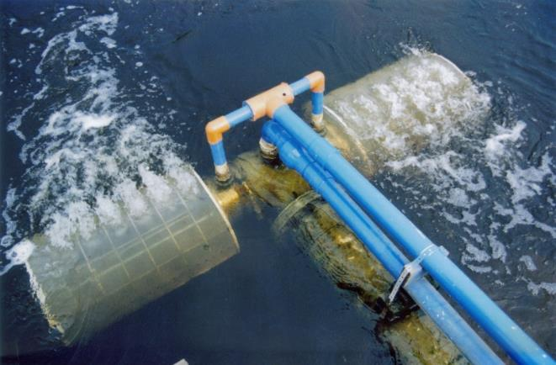
Do look at the technologies available
Self-Cleaning Intake Screens
  Keeps debris out of pump intakes
  Continuously cleans; no debris accumulation
  Fish-safe applications

Slide 14
Don’t be fooled by features
What’s important to you?
What works best for your application?
What service can you expect?

Slide 15
Do use an objective list of criteria
Particle removal efficiency
Flow rate capabilities
Pressure loss
Maintenance requirements & automation
Water loss control

