Slide 1

Eric.Swanson@lakos.com

Slide 2
Topic Overview
Product Overview/Description
Key Advantages
How it Works
Internal Fine Screen
Screen Filter Models
Screen Filter Model Selection
Best Practice Installation
Staged Filtration

Slide 3
Screens: Why ?
Need content on why would someone buy a screen as in … under what circumstance does a screen work?
This slide, in my opinion, addresses the question as to why do I care or why is a separator company selling screens?
Most of the attendees are our distributors who for years have been trained on separators… and so we have to create delineation as to why and where screens work great.
Let me know if you are tight on time and need me to create this.

Slide 4
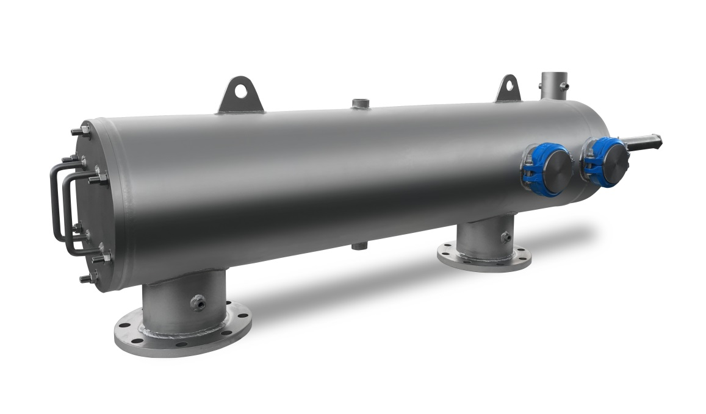

Product Overview/Description
High-efficiency, high-flow screen filtration in a compact footprint
Flow rates from 50 - 7350 GPM
Micron ratings from 5 – 500
Suitable for light solids loading less than 100ppm
Continuous automatic operation, requires no operator intervention
All stainless steel construction
NSF-61 certified

Slide 5
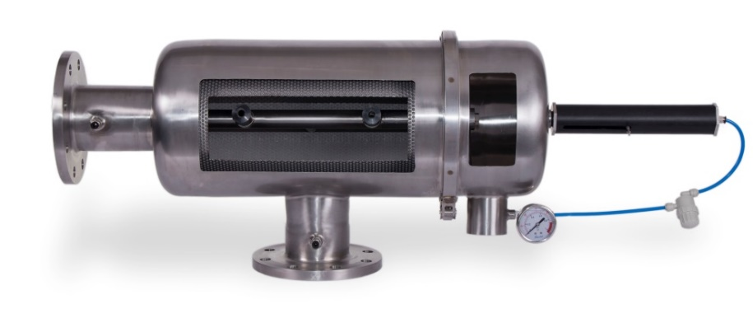
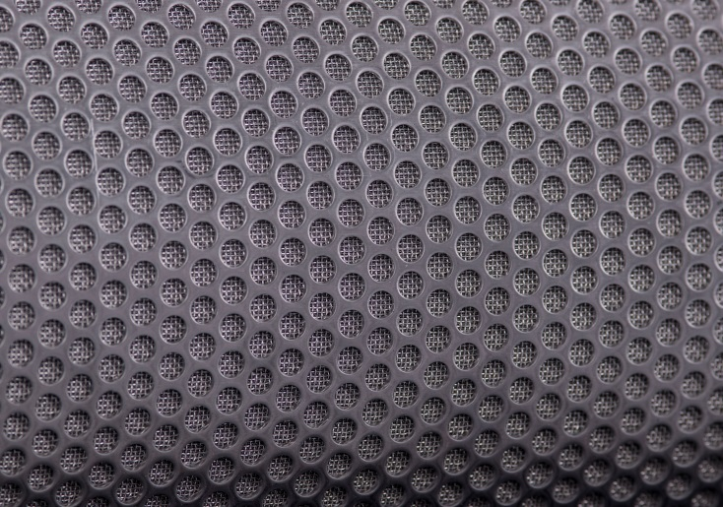
Key Advantages
Heavy Duty Screen Material
  Unlike competitive PVC-backed screens, LAKOS screen is fused to stainless steel plate for maximum durability
Compact Design
  Reduced footprint compared to other types of barrier filtration
Low Water Consumption for Cleaning
  Typically less than 1% of total flow
Continuous Operation
  Backflush does not stop filtration process
  Automatic self-cleaning
Sintered Stainless Screen

Slide 6
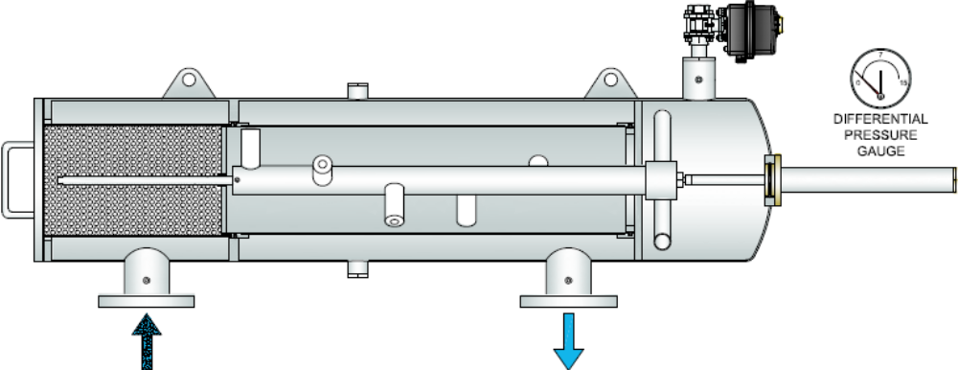
How it Works
Main Components
Flush Valve
¼” Perforated coarse screen
(standard on all dual-screen filter models)
Piston Filter
Fine Screen
Piston
Rod Position Indicator
Particle Remover Rod
Suction Nozzle
Rotating Sprinkler
(Hydraulic model only)
Dirty Water Inlet
Clean Water Outlet
Controller Not Shown

Slide 7
How it Works
Filtration Mode
Example using 50psi inlet pressure
~50psi
50psi
49psi
Dirty Water Inlet
Clean Water Outlet
Dirty water flows inward through the coarse screen (dual-screen models only)
  Large particles trapped on the outside of the coarse screen
Water flows outward through the fine screen
  Small particles trapped on the inside of the fine screen

Slide 8
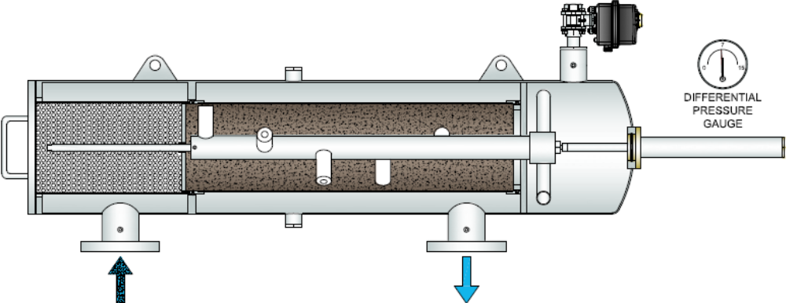
How it Works
Filtration Mode
~50psi
50psi
43psi
Dirty Water Inlet
Clean Water Outlet
Particles build up on the inside of the fine screen until a differential pressure of 7psi between the inlet and outlet is reached
Controller proceeds to initiate a cleaning cycle

Slide 9
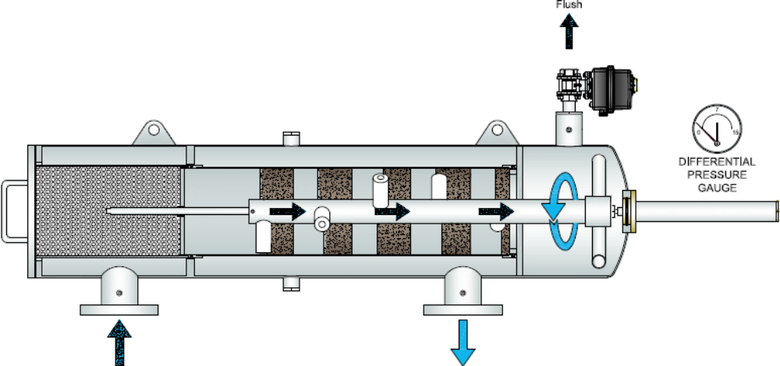
How it Works
Suction Flush Mode
~0psi
Rod position indicator should move all the way to the end before the flush cycle timer ends
<50psi
43 to 50psi
Dirty Water Inlet
Clean Water Outlet
Flush valve opens, creating a vacuum path from the filter inlet to atmosphere for the suction nozzles to pull the debris from the fine screen and out through the flush line
Particle remover rod & nozzles rotate via one of two ways:
  Hydraulic Model (40-150psi): Rotating vacuum sprinkler at end of rod
  Electric/Low-Pressure (15-39psi): Externally-mounted electric motor (not shown above)
Particle remover rod & nozzles are pushed horizontally due to the incoming water flow and pressure
  *Important to monitor rod position indicator on piston for a FULL sweep

Slide 10
How it Works
Return to Filtration Mode
~50psi
50psi
49psi
Dirty Water Inlet
Clean Water Outlet
Flush valve closes and the piston pushes the particle remover rod back to its original position.
  Make sure rod position indicator has fully returned to its home position.
After a cleaning cycle, differential pressure should drop back down to 0-1psi

Slide 11
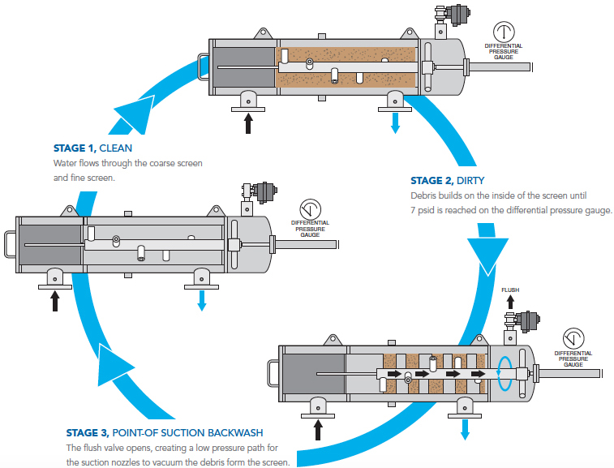
How it Works - Summary

Slide 12
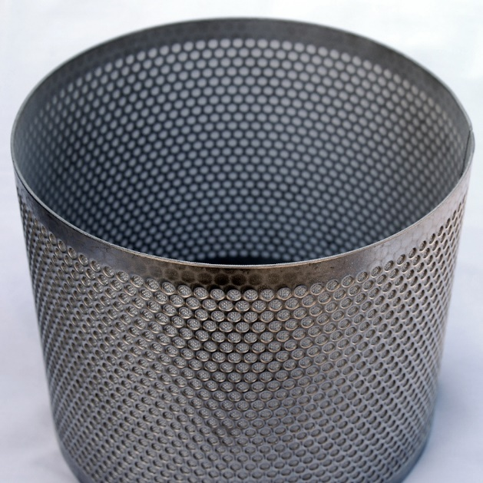
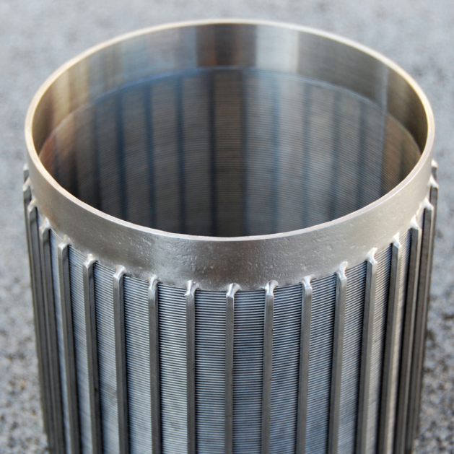
Internal Fine Screen
Sintered
STANDARD
Wedge Wire Slotted
Optional
316L Stainless Steel
Screen fused to stainless steel perforated plate for durability
Micron Options: 5, 10, 25, 50, 75, 100, 120, 150, 200, 300, 500
316L Stainless Steel
Better suited for removal of fibrous material
Micron Options: 25, 50, 75, 100, 120, 150, 200, 300, 500

Slide 13
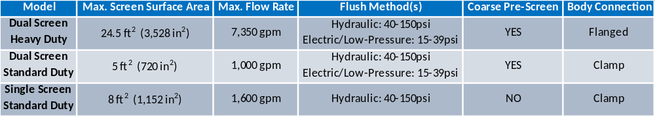

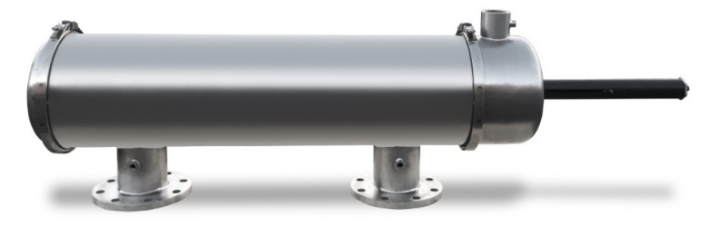


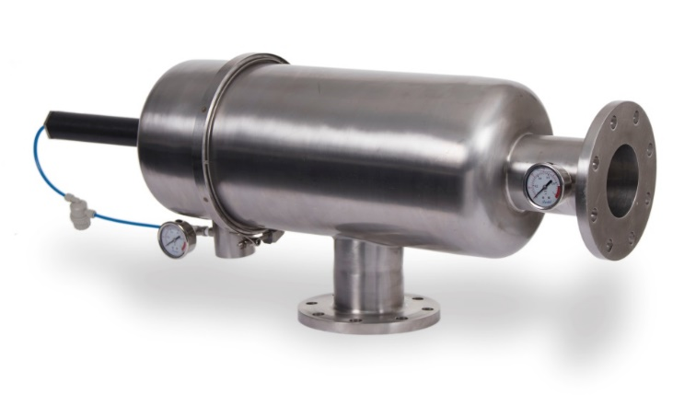
Screen Filter Models
All filter models meet the following criteria:
150psi maximum pressure rating
200°F maximum temperature rating
304L stainless housing with 316L stainless internal screen
Dual Screen Standard Duty
Dual Screen Heavy Duty
Single Screen Standard Duty

Slide 14
Screen Filter Model Selection
Required information for model selection:
Flow Rate
Micron filtration required - Dependent on downstream filtration requirements for downstream equipment to operate properly
TSS Solids loading (ppm) – Can be estimated based on similar known water source solids loading
Inlet Pressure
Used to determine minimum required screen surface area
Used to determine flush method
40-150psi = Hydraulic
15-39psi = Electric/Low-Pressure

Slide 15
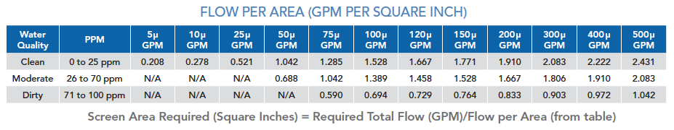
Screen Filter Model Selection
Screen Area Calculation
Flow Rate – Higher flows require more screen area
Micron filtration required – Smaller micron screens require more screen area
TSS Solids loading (ppm) – Higher solids loading require more screen area

Slide 16
Screen Filter Model Selection
Screen Area Calculation
Example
Flow Rate – 1000 gpm
Micron filtration required – 100 micron
TSS Solids loading (ppm) – Average/Moderate 26-70ppm
Inlet Pressure – 50psi
Minimum Screen Area Required = 1000 gpm ÷ 1.389 = 720 in² = 5 ft²

Slide 17
Screen Filter Model Selection
Screen Area Calculation
Example (cont.)
Flow Rate – 1000 gpm
Micron filtration required – 100 micron
TSS Solids loading (ppm) – Average/Moderate 26-70ppm
Inlet Pressure – 50psi
Minimum Screen Area Required = 1000 gpm ÷ 1.389 = 720 in² = 5 ft²
Model Selection Options:
6” Dual Screen Standard Duty Hydraulic with 5 ft² of 100 micron screen area
6” Single Screen Standard Duty Hydraulic with 5 ft² of 100 micron screen area

Slide 18
Screen Filter Model Selection
Screen Area Calculation
Example (cont.)
Flow Rate – 1000 gpm
Micron filtration required – 50 micron
TSS Solids loading (ppm) – Average/Moderate 26-70ppm
Inlet Pressure – 50psi
Minimum Screen Area Required = 1000 gpm ÷ 0.688 = 1453 in² = 10.1 ft²
Selecting a smaller micron screen results in a larger screen area requirement

Slide 19
Screen Filter Model Selection
Screen Area Calculation
Example (cont.)
Flow Rate – 1000 gpm
Micron filtration required – 50 micron
TSS Solids loading (ppm) – Average/Moderate 26-70ppm
Inlet Pressure – 50psi
Minimum Screen Area Required = 1000 gpm ÷ 0.688 = 1453 in² = 10.1 ft²
Only one model selection:
6” Dual Screen Heavy Duty Hydraulic with 12.25 ft² of 100 micron screen area

Slide 20
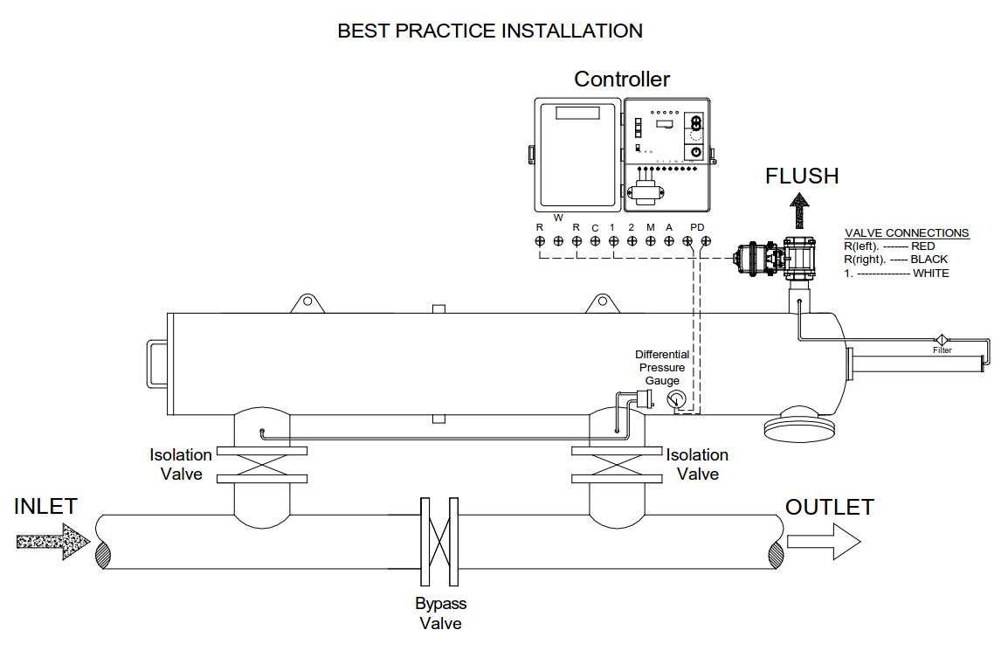
Best Practice Installation

Slide 21
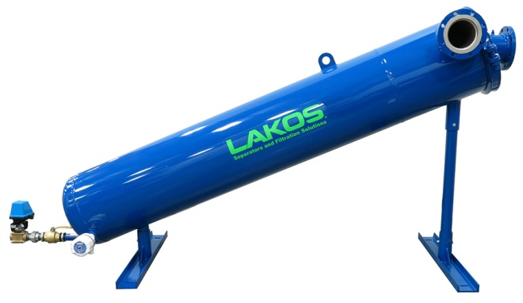
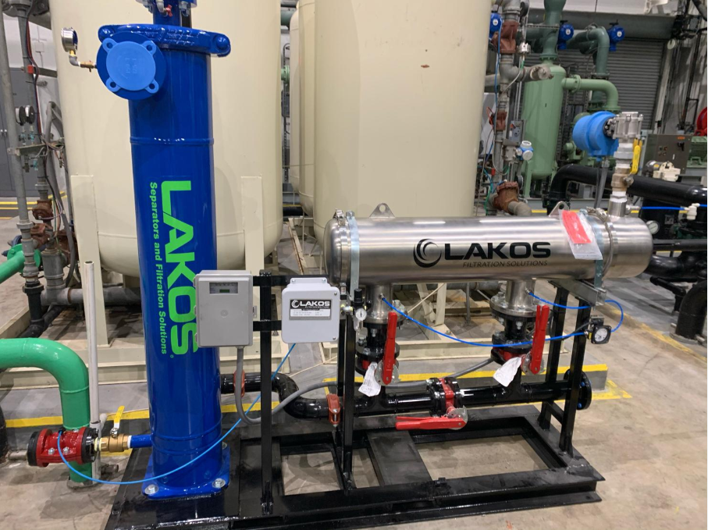

Staged Filtration Solutions
For applications with both heavy solids (sand, grit, scale) and lights solids (organics, silt, etc.), staged-filtration is recommended.
A LAKOS Separator can be installed before a screen filter to remove the heavier particles and allow the screen filter to act as a polishing filter afterwards.

Slide 22

Contact Information

