Slide 1
LAKOS Products & Solutions
Industrial Factory Training
March 28 – 29, 2019
Presenter: Tom Cabezut

Slide 2
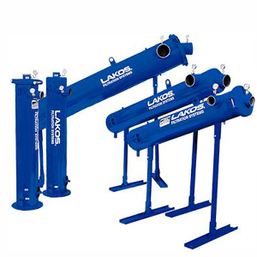
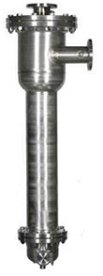
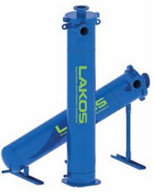
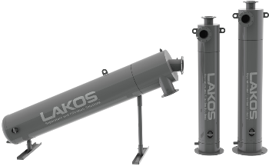
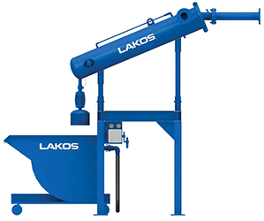
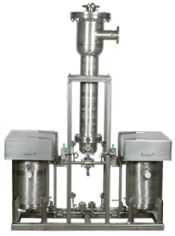
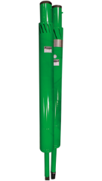
Products
SETTLEABLE SOLIDS
Non-Barrier Filters
JPX-JPL - Standard Efficiency Separators
eJPX - High Efficiency Separators
PWC - Municipal NSF-61 Separators
CSX – Hot Cooking Oil Separator
PPS - Pump Protection Separators
PRX – Solids Handling Solution
FrySafe – Hot Cooking Oil System

Slide 3
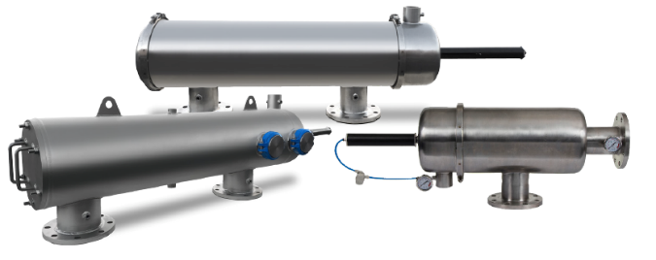
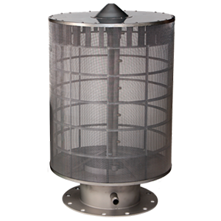
Products
FLOATING SOLIDS
Barrier Filters
ISF – OPEN WATER
INTAKE SCREENS
SF – SELF CLEANING SCREENS

Slide 4
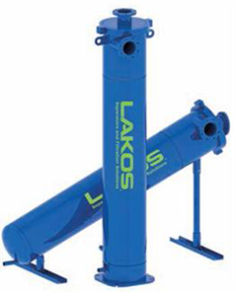
Separators – Standard & High Efficiency
Features
  Patented - Centrifugal Action Based
  No moving parts
  Low and Steady Pressure Loss
  eJPX: 3rd party tested performance
Options
  Stainless and Skotchkote
  High Temperature and High Pressure
Solution
  Pre-filtration, Protect H/X, Spray Nozzles, and Reduce waste
  Prevent Solids Accumulation in Basins
JPX-JPL - Standard Efficiency Separators
eJPX - High Efficiency Separators
FLOW RANGE
Standard Efficiency
4 US GPM to 12,750 US GPM
1 m³/hr to 2,896 m³/hr
High Efficiency
55 US GPM - 1,030 US GPM
12.5 m³/hr - 233 m³/hr

Slide 5
Separators – Solids Handling Solution
Features
  Turn key solids handling solution
  Includes Solids Disposal Solutions (Drum or Hopper)
  Available with eJPX or JPX Separators
Options
  Stainless and Skotchkote
  High Temperature and High Pressure
Solution
  Keeps Solids out of process and isolated
  Allows for easy disposal of separated solids
PRX – Solids Handling Solution

Slide 6

Separators – Municipal Separator
Features
  Patented - Centrifugal Action Based
  NSF-61 Compliant Separator
  No moving parts – Zero maintenance
  Low and Steady Pressure Loss
Solution
  NSF Rated Separators for Municipal applications
  Protect downstream equipment
PWC - Municipal NSF-61 Separators
FLOW RANGE
4 US GPM to 12,750 US GPM
1 m³/hr to 2,896 m³/hr

Slide 7
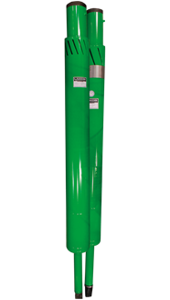
Well Water Pump Protection Separators - PPS
Features:
  Protect Submersible & Turbine well water pumps from sand damage – Extend Pump Life
  Reduce downstream equipment maintenance due to sand
  Minimizes breakdowns and replacements
  Sand is released deeper into the well
Benefits:
  Protect pump impellers from sand abrasion
  Controls excessive efficiency loss and energy costs
  Minimizes breakdowns and replacements of pumps or downstream equipment
Flow Range
100 - 3,180 US GPM
23 - 723 m³/hr

Slide 8
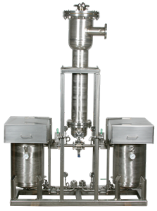
Hot Cooking Oil Separators & Systems
Features
  Patented - Centrifugal Action Separators
  Engineered to Remove Fines & Crumbs
  No moving parts
  Low and Steady Pressure Loss
  System: Turn-key solution with safety features
Options
  Carbon and Stainless
Solution
  Extend run times, Maintain oil quality, Eliminate fines box fires, and Reduce maintenance
CSX – Hot Cooking Oil Separator
FrySafe – Hot Cooking Oil System
FLOW RANGE
Separators
50 US GPM to 6,125 US GPM
12 m³/hr to 1,390 m³/hr
Frysafe Systems
75 US GPM to 4,250 US GPM
17 m3/hr to 965 m3/hr

Slide 9
Open Water Intake Screens – Barrier Filters
Features:
  Protect Pumps from floating debris in open water intakes
  Backwash spray nozzles keep screen clear of debris
  All stainless (304) body and screen (316)
  Mesh Options: 10 mesh and 30 mesh
Options:
  Phosphorous Bronze screen option
Benefits:
  Protect Pump from open water floating debris
  Automatic screen cleaning for reduced maintenance
ISF – OPEN WATER
INTAKE SCREENS
Flow Range
Up to 2,700 US GPM
Up to 613 m³/hr

Slide 10

Self-Cleaning Screen Filters – Barrier Filters
Features:
  Self-cleaning Barrier Filters with minimal backwash water waste
  Minimal pressure loss
  All stainless (304) body and screen (316)
  Screen micron options: 5um to 500um
  Maximum particle count: 100ppm
Options:
  Sintered vs wedge wire screens
  Hydraulic or Electric valve options
  Dual screen – Coarse + fine screen
Benefits:
  Remove Floating Debris from cooling water
  Benefits of Barrier filters with no sand or bags to replace
Flow Range
15 US GPM to 7,350 US GPM
3.4 m³/hr to 1,669 m³/hr

Slide 11
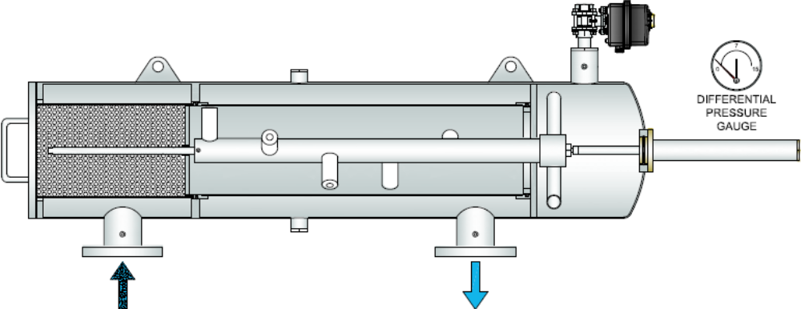
Self-Cleaning Screen Filters: Filter Mode
2
1
1. Water flows through the coarse screen, which traps large particles
2. Then through the micron-rated fine screen where suspended particles are trapped

Slide 12
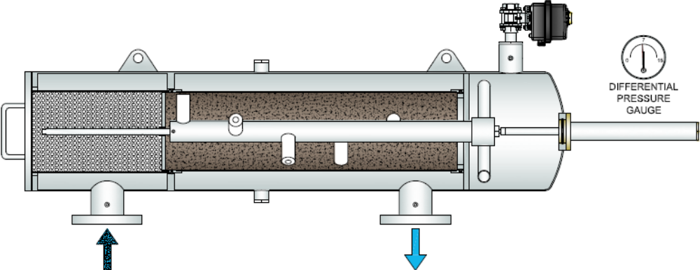
Self-Cleaning Screen Filters: Dirt Build Up
Particles build on the inside of the screen until 7 PSI is reached on the differential pressure gauge

Slide 13
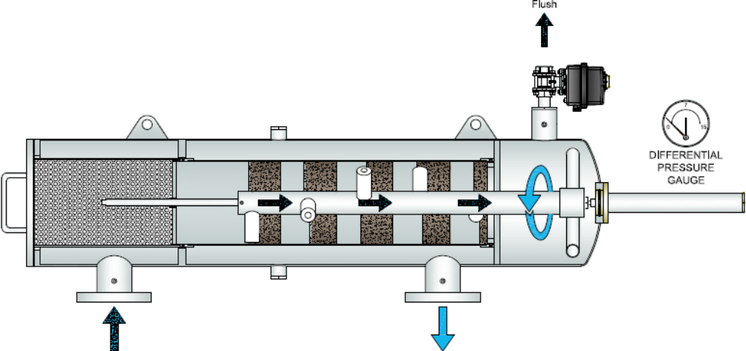
Self-Cleaning Screen Filters: Suction Cleaning
1
2
1. The flush valve opens, creating a low pressure path for the suction nozzles to vacuum
the debris from the screen
2. Suction nozzles are moved with an electric motor or a hydraulic cylinder

Slide 14

Self-Cleaning Screen Filters: Clean Again
Cleaning cycles continue until differential pressure drops below 1 PSI. The filter continues normal operation uninterrupted.
Cleaning cycle is adjusted by programmable timer

Slide 15
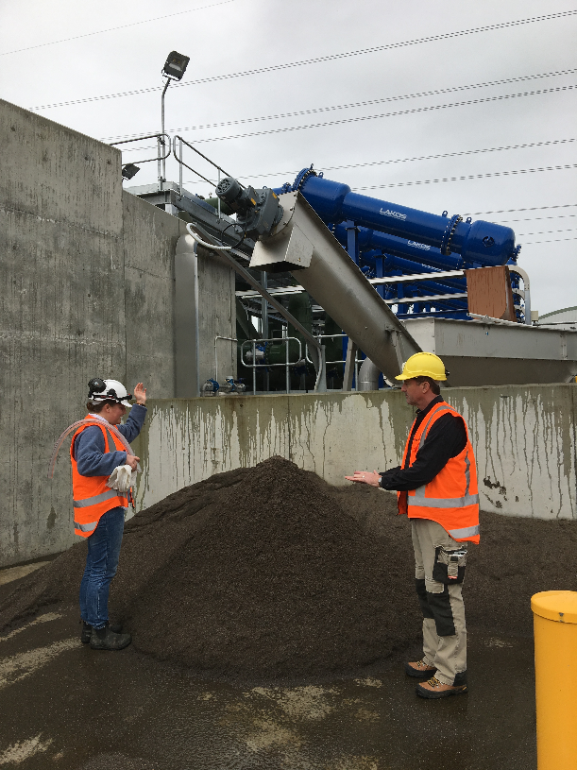
Key Takeaways
Confirm what materials we are trying to remove (sink/float or both)
If there is doubt about what to use, contact factory or regional manager
We can we use multiple products to resolve their issues

Slide 16

Separators – How it Works

